Slide 1
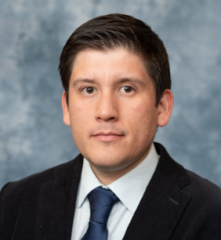

2nd Annual Undergraduate Quantitative Biology Summer School
Tutorial 1_1: Basic Image manipulation in a Python interactive notebook
Instructor: Luis Aguilera
e-mail: luis.aguilera@colostate.edu

Slide 2



Digital images
Outline
Program
Digital images
Image sequence
Filters
Maximum projection
What is an image?
Illumination source
Acquisition
system
Real object
Image is a matrix of data

Slide 3
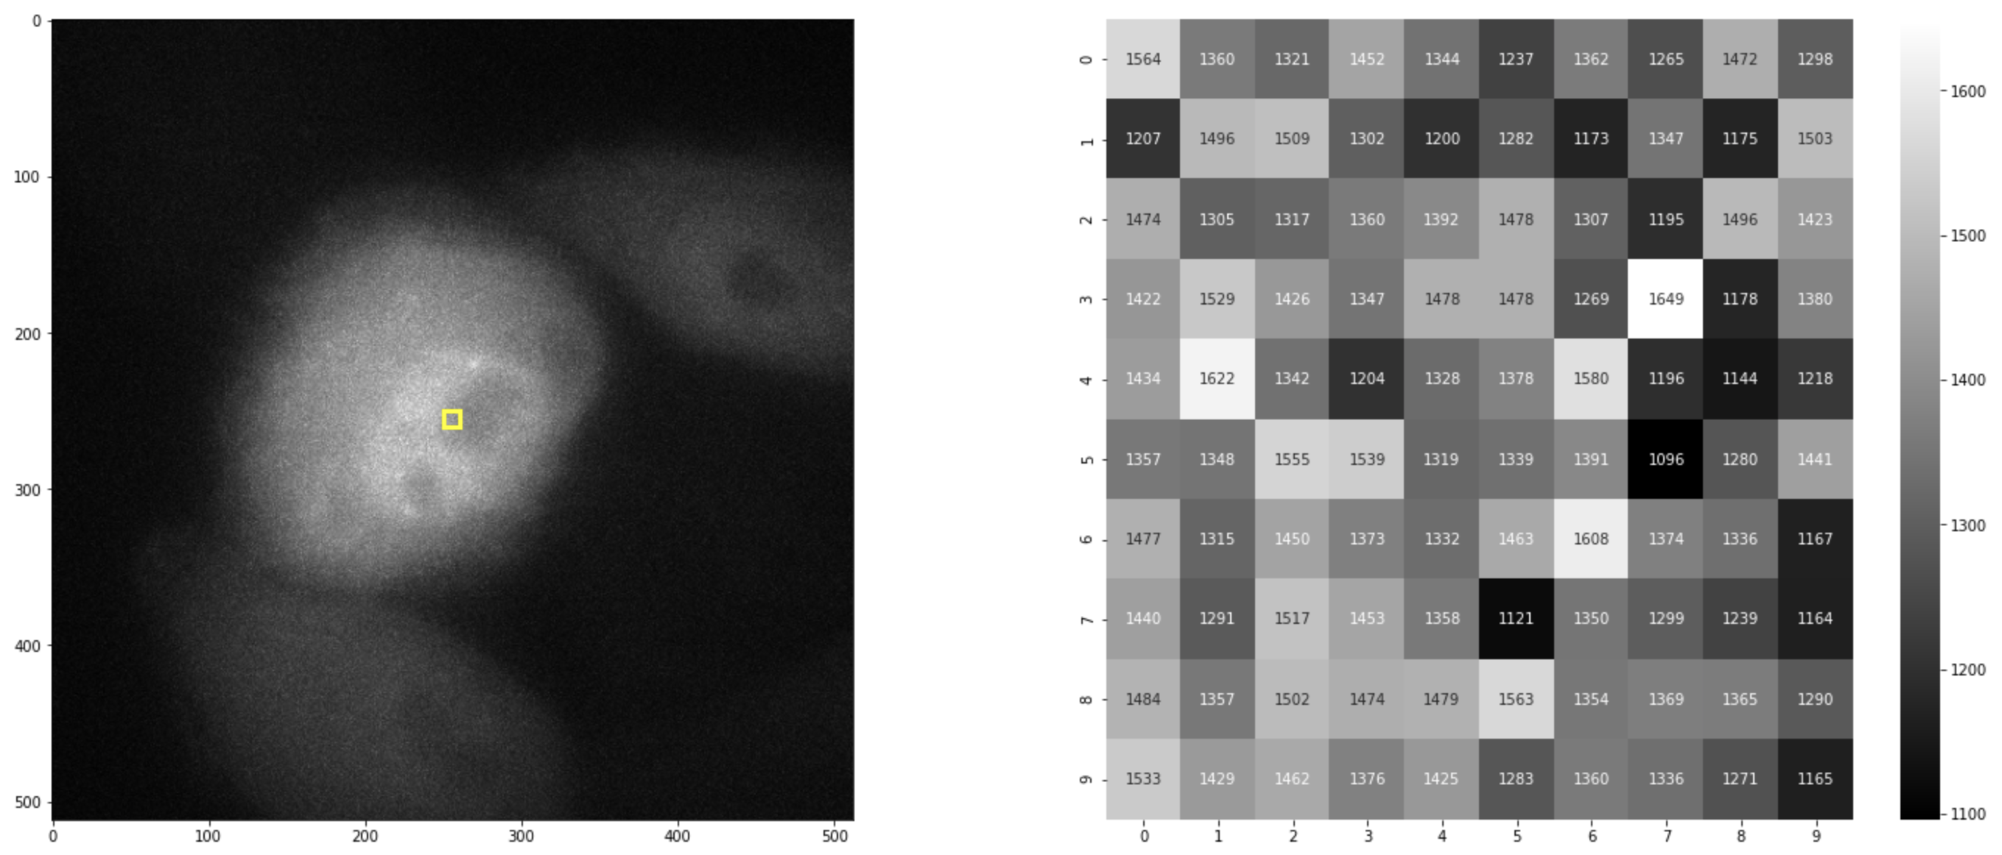
Digital image
Outline
Program
Digital images
Image sequence
Filters
Maximum projection
What is an image?

Slide 4
Image sequence
Outline
Program
Digital image
Image sequence
Filters
Maximum projection
Sequences of images (3D image, Color image, Video)?
2D image
[Y,X]
Tensor
3D image
[Y,X,C]
Tensor
nD array of images
[T,Y,X,C]

Slide 5
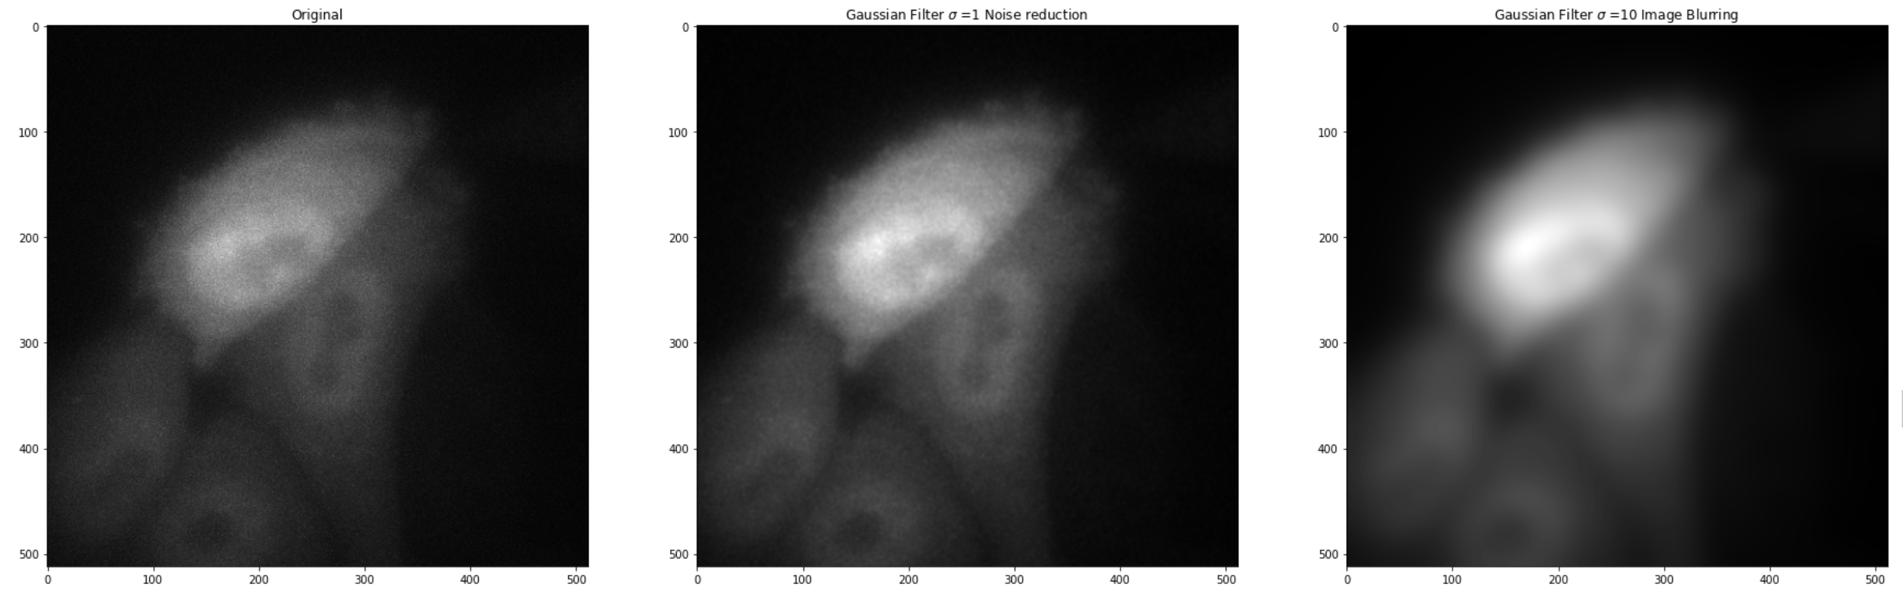
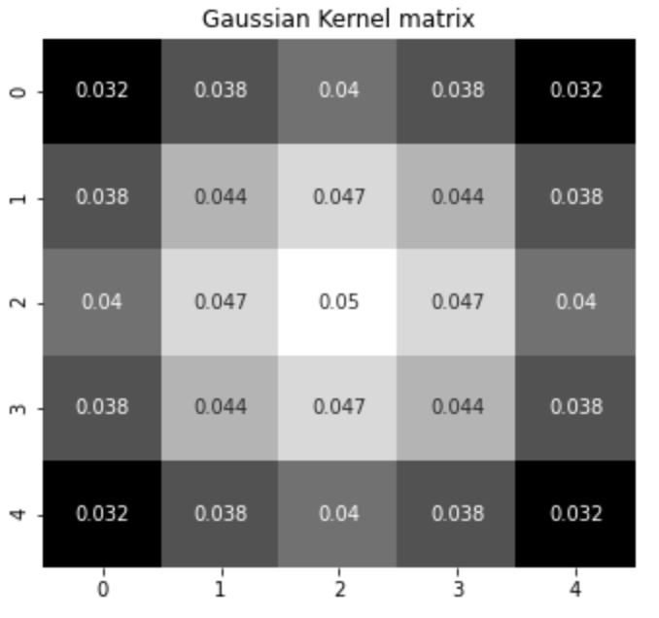
Filters
Outline
Program
Digital image
Image sequence
Filters
Maximum projection
Filters – 2D Convolution
Pixel-by-pixel
Mathematical operation
Kernel matrix
[5px,5px]
Original 2D image
[512px,512px]
Filtered 2D image
[512px,512px]

Slide 6

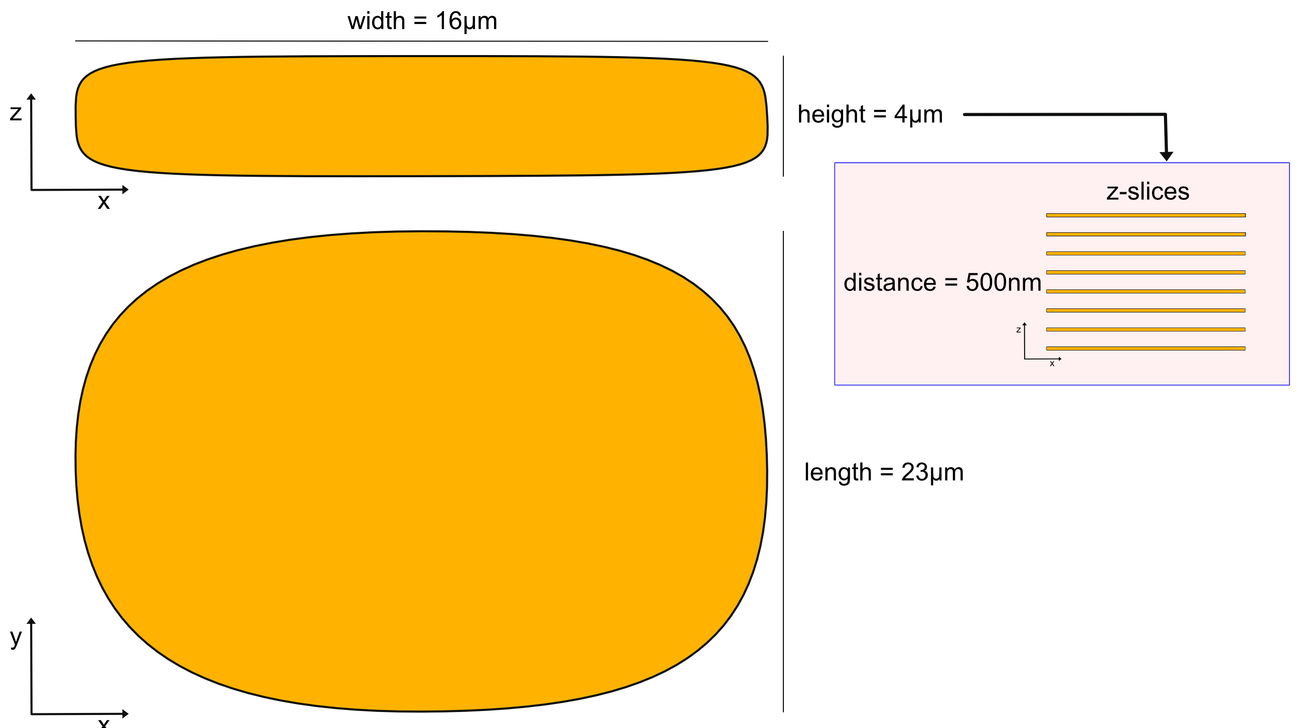

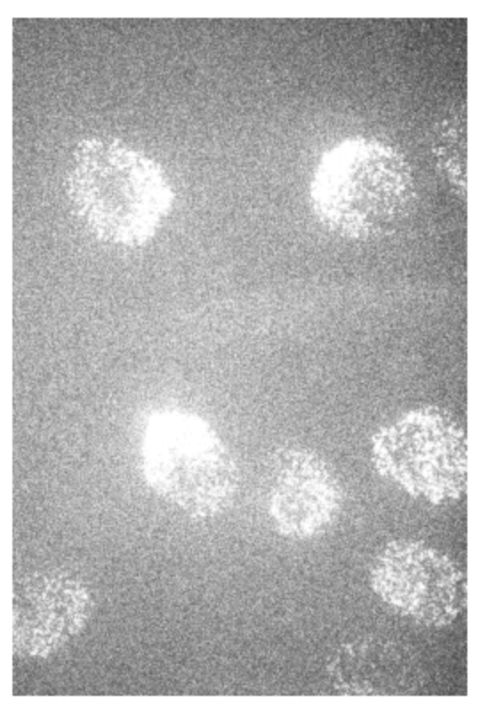
Maximum projection
Outline
Program
Digital image
Image sequence
Filters
Maximum projection
Maximum projections
Images with 3-dimensional space.
z=0
z=1
max(img)
z=2
y
x
z=3
y
x

